Slide 1
Chapter 2: System Calls and Programming

Slide 2
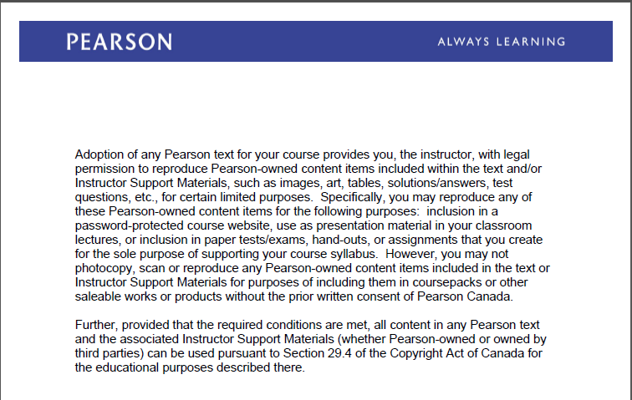
Text Book Slides – Copy Right

Slide 3
System calls and Programming
C-code components
Compilers and Interpreters
Pointers
System Calls
Types of System Calls
Operating System Debugging
How the shell works

Slide 4
System calls and Programming

Slide 5
C programming Language
C programming Language is a structured , procedural language, it was developed in 1972 by Dennis Ritchie at Bell Labs and in 1978 Kernighan & Ritchie published the first edition C programming language book.
In 1972 large part of Unix operating system was rewritten in C language
ANSI C was completed in 1988

Slide 6
C Program Components
1. Header files are required by C library functions such as printf
#include <header_file.h>
e.g. In Linux the command man 3 printf will provide the header file required by
printf( ) function
2. #define constants
3. Declare Global variables outside the main( ) function
4. main ( ) is the default function of C programming.
main ( ) {
declare local variables for this function
C library functions
call user-defined functions
}
5. Declare user-defined functions { declare local variables}

Slide 7
C-code example

Slide 8
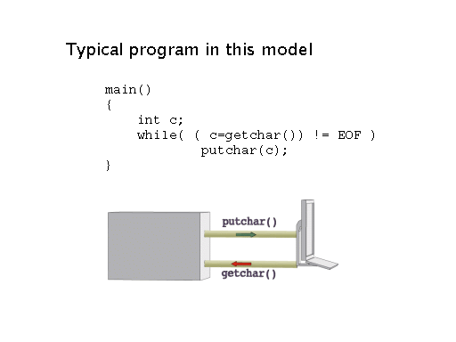

Slide 9
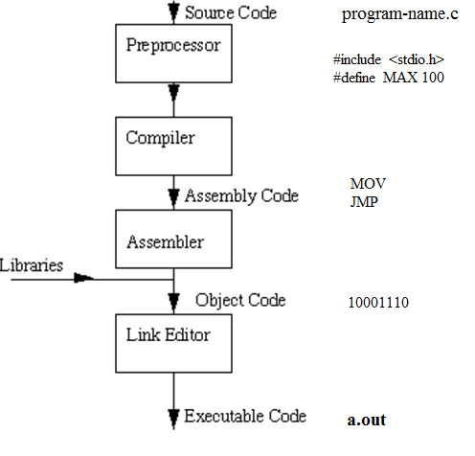
Compilers – Compilation process
https://www.youtube.com/watch?v=CSZLNYF4Klo
https://www.youtube.com/watch?v=VDslRumKvRA

Slide 10
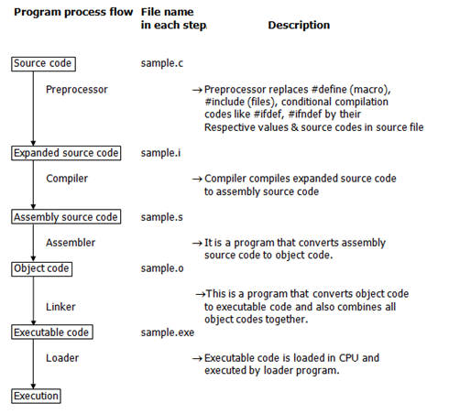
Compiler
http://users.cs.cf.ac.uk/Dave.Marshall/C/

Slide 11
Compilers
Pre-processor also known as cpp (check linux man cpp)or macro processor that transform source code before compilation.
Pre-processor output: gcc -E program.c
https://gcc.gnu.org/onlinedocs/cpp/Preprocessor-Output.html
Assembly code. You can use objdump with –D option to display assembler code of machine instructions. e.g.
gcc -g -c program.c It will generate an .o file
objdump -d -S program.o It will displays assembly code
3. Link to libraries needed by the program and not explicit in the C code
e.g. gcc program.c -lm It will link to math library
Executable code
gcc program.c It will generate executable a.out

Slide 12
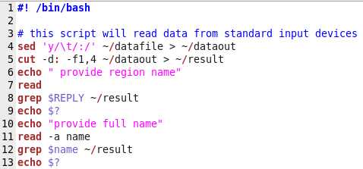
Interpreters
Interpreter interprets commands or instructions line by line such as shells. e.g. the following script will be interpreted by bash shell.

Slide 13
Pointers
A pointer is a variable that contains the memory address of another variable. We can have a pointer to any variable type.
& provides the memory address of a variable.
The dereference operator * refer to the content of variable pointed by a pointer.
Declare a pointer to a variable: int *pointer;
We must associate a pointer to a particular type. A pointer is declared an integer type because we can increment or decrement the pointer by integer values e.g ++ *pointer, but the content of a pointer is not an integer, it is a memory address type.
Consider the effect of the following code:
int x = 1, y = 2, *ip;
ip = &x;
y = *ip;
*ip = 3;

Slide 14
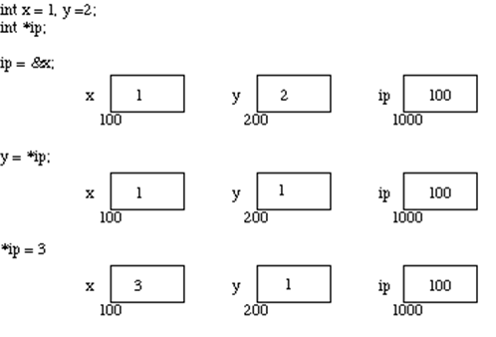
Pointers

Slide 15
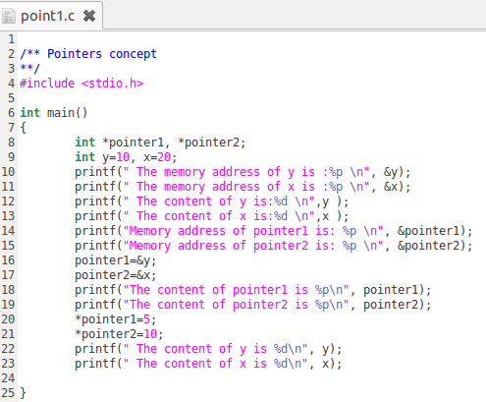
Pointers C-Code

Slide 16
System Calls
System calls are routines written in a high-level language (C and C++)
System calls provide an interface to the services provided by the OS kernel. Systems execute often thousands of system calls.
e.g The user executes printf( ) function which invokes write() system call to perform the output
API specifies a set of functions including parameters that are available to an application programmer. Application developers mostly design programs based on an Application Program Interface (API). APIs invokes system calls
Three most common APIs are Win32 API for Windows, POSIX API for POSIX-based systems (including virtually all versions of UNIX, Linux, and Mac OS X), and Java API for the Java virtual machine (JVM)

Slide 17
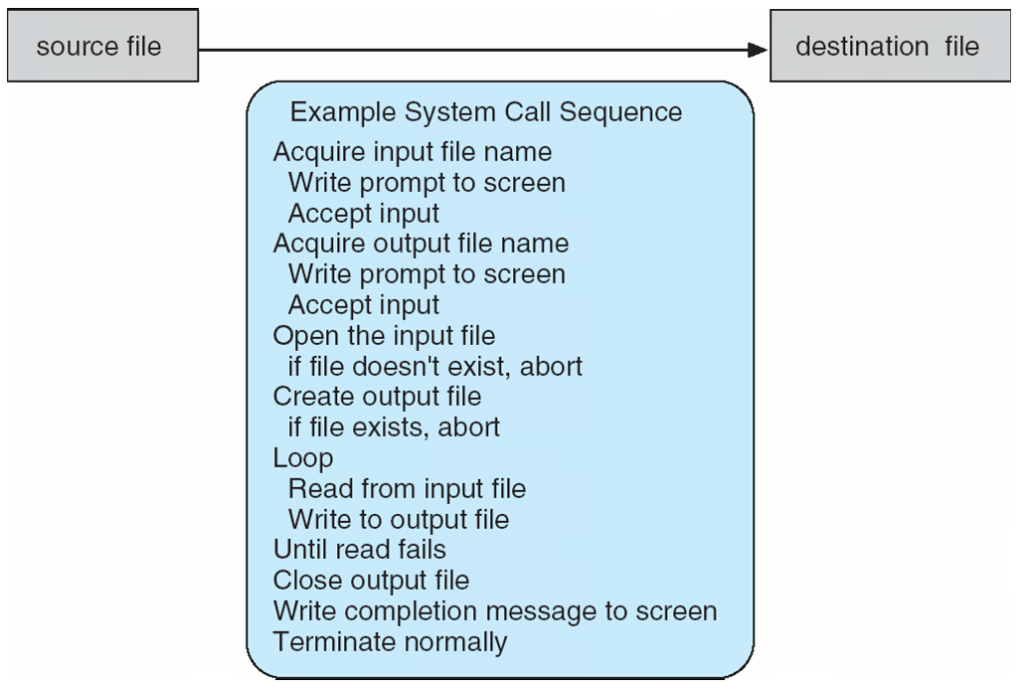
Example of System Calls
System call sequence to copy the contents of one file to another file

Slide 18
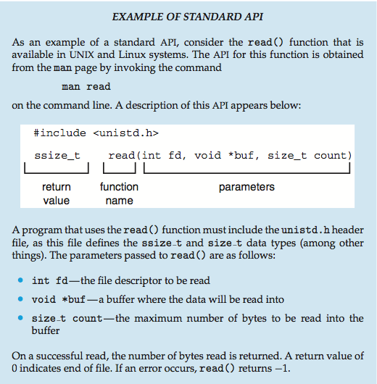
Example of Standard API

Slide 19
System Call Implementation
Every system call is associated with a number and the System-call interface maintains a table indexed according to these numbers
The system call interface invokes intended system call in OS kernel and returns status of the system call and any return values
Most details of OS interface are hidden from the programmer by API and managed by run-time support library (set of functions built into libraries included with a compiler)
Often, more information is required than simply identity of desired system call
Exact type and amount of information vary according to OS and call. e.g to “get an input” a file or device is needed as a source as well as the address and length of memory buffer where the input should be read is required.

Slide 20
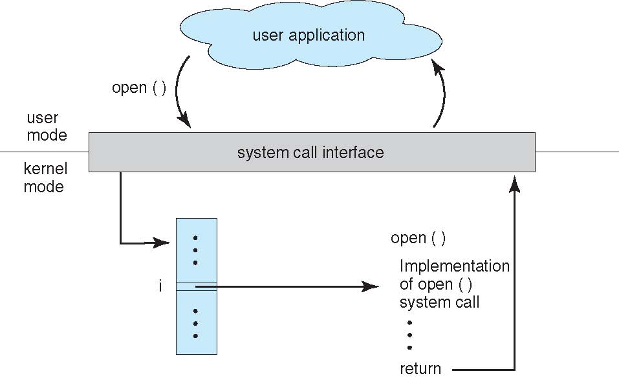
API – System Call – OS Relationship

Slide 21
Standard Libraries
Shared libraries are collections of routines needed by a program to work.
There are number of standard libraries used by more than one process at the same time.
As these libraries are only loaded when the process is run, they are also known as dynamically linked libraries (DLL)
Libraries in Unix system are called libc. Shared libraries in Linux have extension .so in Windows .dll (DLL)

Slide 22
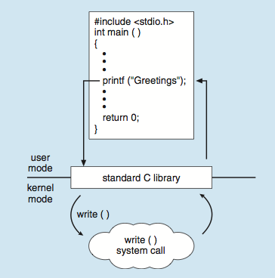
Standard C Library Example
C program invoking printf() library call, which calls write() system call

Slide 23
System Call Parameter Passing
Three general methods used to pass parameters to the OS
1. Simplest: pass the parameters in registers
In some cases, there are more parameters than registers
2. Parameters stored in a block, or table, in memory, and address of block passed as a parameter in a register
This approach is taken by Linux and Solaris
3. Parameters placed, or pushed, onto the stack by the program and popped off the stack by the operating system
Block and stack methods do not limit the number or length of parameters being passed

Slide 24
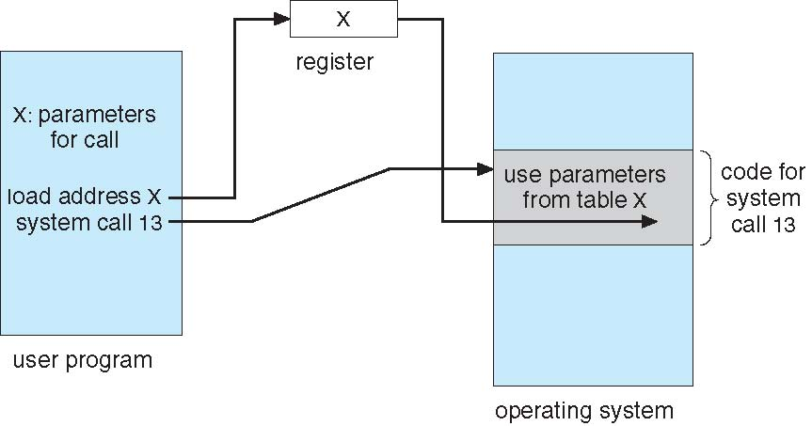
Parameter Passing via Table

Slide 25
Types of System Calls
Process control
end, abort
load, execute
create process, terminate process
get process attributes, set process attributes
wait for time
wait event, signal event
allocate and free memory

Slide 26
Types of System Calls
File management
create file, delete file
open, close file
read, write, reposition
get and set file attributes
Device management
request device, release device
read, write, reposition
get device attributes, set device attributes
logically attach or detach devices

Slide 27
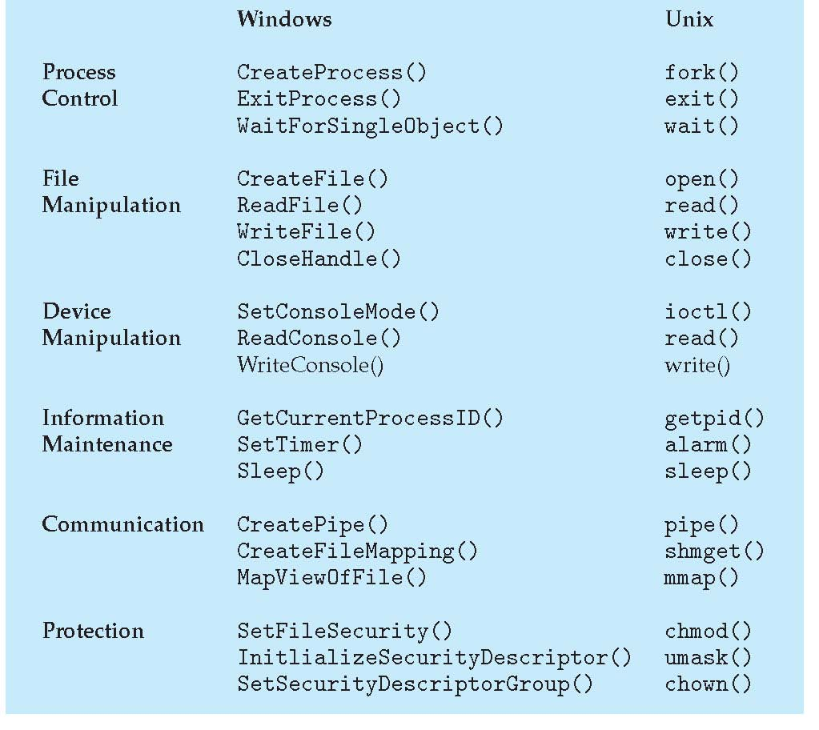
Examples of Windows and Unix System Calls

Slide 28
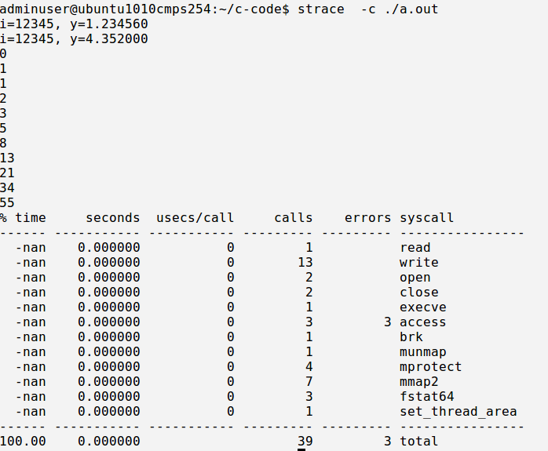
Strace and System calls

Slide 29
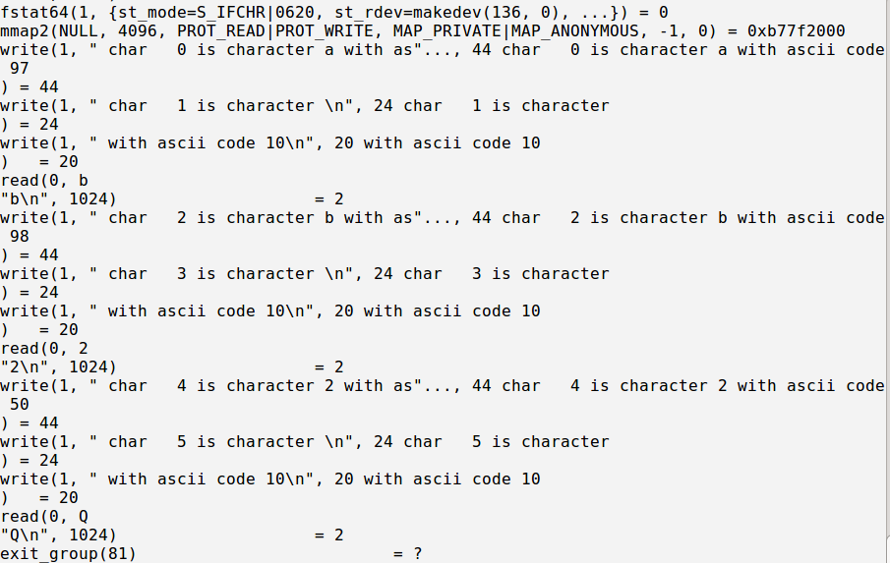
Strace and System Calls

Slide 30
How does the Shell work ?
The shell is a program that interprets commands.
The shell performs the following:
1. The shell reads input from STDIN
2. It parses the line(input) into tokens to get the command and arguments
3. The shell (parent process) creates (clones ) a new process by calling
fork( ) system call to replicate itself (a child process).
4. The program (command) is loaded into the new process (child
process) and the arguments argv[] are passed to the program
5. The child process executes the program by invoking exec( ) system call
to execute the program (command ) with the respective arguments.
6. The parent process waits (wait() system call) for child process status

Slide 31
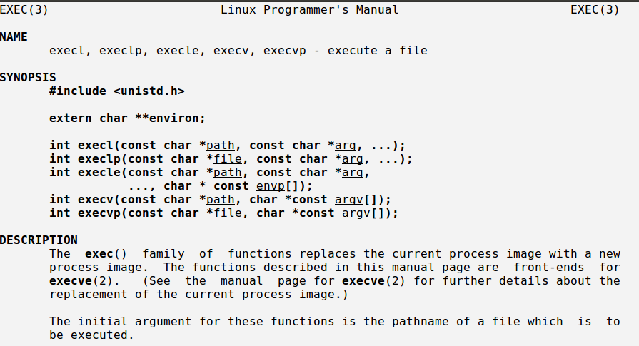
Linux man exec( ) System Call

Slide 32
execvp( ) System Call
Execvp() executes a program with path searching
#include <unistd.h>
execvp( const char *file, const char *argv[])
*file pointer to the file(program to execute)
*argv[] array of strings
Example
execvp( arglist[0], arglist )
execvp( “ls” , arglist )

Slide 33
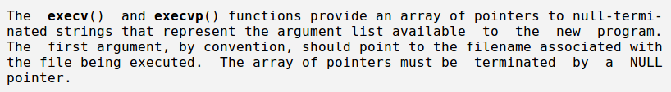
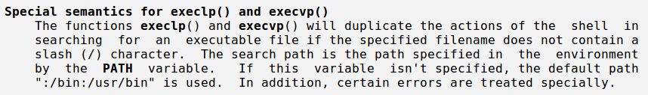
execvp( ) System Call

Slide 34
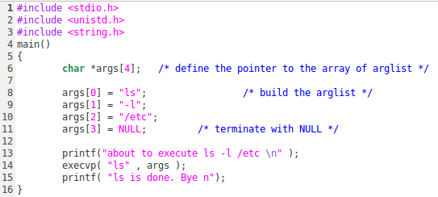
Shell Programming

Slide 35
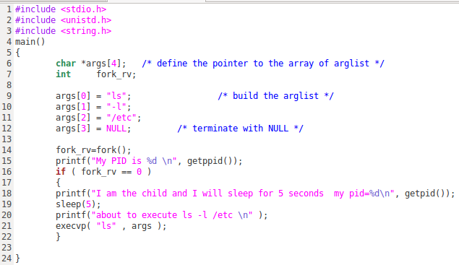
Shell Programming

Slide 36
System programs

Slide 37
System Programs
System programs provide a convenient environment for program development and execution. Some of them are simply user interfaces to system calls; others are considerably more complex. They can be divided into:
File manipulation
Status information sometimes stored in a File modification
Programming language support
Program loading and execution
Communications
Background services
Application programs
Most users’ view of the operation system is defined by system programs, not the actual system calls

Slide 38
System Programs
File management - Create, delete, copy, rename, print, dump, list, and generally manipulate files and directories
Status information
Some ask the system for info - date, time, amount of available memory, disk space, number of users
Others provide detailed performance, logging, and debugging information
Typically, these programs format and print the output to the terminal or other output devices
Some systems implement a registry - used to store and retrieve configuration information

Slide 39
System Programs (Cont.)
Programming-language support - Compilers, assemblers, debuggers and interpreters sometimes provided
Program loading and execution- Absolute loaders, relocatable loaders, linkage editors, and overlay-loaders, debugging systems for higher-level and machine language
Communications - Provide the mechanism for creating virtual connections among processes, users, and computer systems
Allow users to send messages to one another’s screens, browse web pages, send electronic-mail messages, log in remotely, transfer files from one machine to another

Slide 40
Operating-System Debugging
Debugging is finding and fixing errors, or bugs
OSes generate log files containing error information
Failure of an application can generate core dump file capturing memory of the process
Operating system failure can generate crash dump file containing kernel memory
gdb debugger http://man7.org/linux/man-pages/man1/gdb.1.html
Kernighan’s Law: “Debugging is twice as hard as writing the code in the first place. Therefore, if you write the code as cleverly as possible, you are, by definition, not smart enough to debug it.”

Slide 41
Text Book Slides – Copy Right

Slide 42
End of Chapter 2

